Slide 1
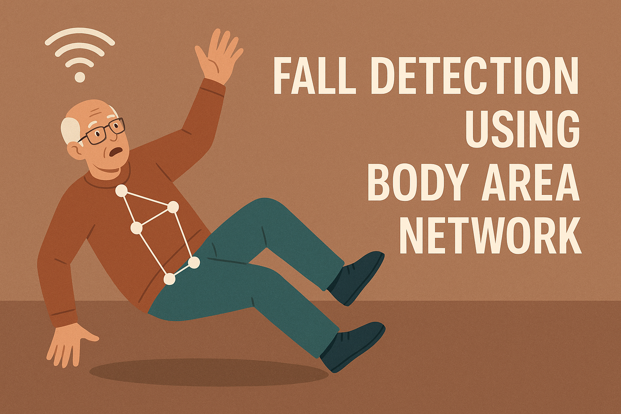
Kunal Pal
T91/IT/216006
211-1111-0347-19
Indranil Kundu
T91/IT/216005
115-1111-0431-19
Kunal Pal
T91/IT/216006
211-1111-0347-19
Under the supervision of
Prof. Joyati Mondal

Slide 2

INDEX
Introduction
Problem Statement
Comparison of Related Works
System Architecture
Hardware Implementation
Machine Learning Implementation
ML Training Result
App UI , Simulated Fall Detection & Alert System Demo
Our Contribution
Limitations
Future Work
Conclusion
References

Slide 3
INDEX
INTRODUCTION
Our project is a smart wearable system that helps monitor a person's health in real-time and can detect if they fall down.
It’s like a wristband that checks your heart rate, body temperature, and movement using small sensors. If it senses a sudden fall, it sends an alert with your location through email to your family or caregivers — and even shares nearby hospital info.
All the data goes online instantly using Wi-Fi, and we use a machine learning model — trained with a large dataset — to accurately tell the difference between a normal movement and a real fall.
We also made a mobile app where users can see their health stats live. In the future, we plan to add AI to give simple health advice based on the data.
This system is especially useful for elderly people who live alone, as it helps keep them safe and connected.
1

Slide 4
INDEX
PROBLEM STATEMENT
Elderly individuals who live alone are highly vulnerable during medical emergencies, especially when accidental falls occur. The lack of real-time monitoring and delay in emergency response can lead to severe health consequences. Despite advances in health wearables, existing solutions are often expensive, lack AI-powered insights, and fail to provide immediate contextual alerts to caregivers. This project addresses these shortcomings by delivering a reliable, affordable, and scalable real-time health monitoring and fall detection system.
2

Slide 5
COMPARISON TABLE OF RELATED WORKS
INDEX
Feature / Aspect | Typical "Past Related Work" / Conventional Systems | Body Area Network System
Detection & Monitoring | Basic rule-based fall detection; limited single-sensor health data. | AI-Powered ML Fall Detection (high accuracy); Multi-sensor Wearable for comprehensive vital signs.
Data Flow & Intelligence | Manual data entry or batch processing; raw data output. | Real-time IoT Streaming (ThingSpeak): Continuous data flow. GenAI (Google Gemini) Insights for plain-text health advice.
Alerting & Context | Simple SMS/call alerts; no location or context. | Automated, Adaptable Alerts: Detailed, location-based (OpenStreetMap) emails; extensible to SMS/WhatsApp.
User Experience | No app, dated interface, or generic health display. | Simple, Personalized Flutter App: Optimized UI for older users, user setup, device pairing, tailored dashboard.
Cloud & Scalability | Local servers or limited infrastructure; poor scalability. | Cloud-Native Deployment (Render): Robust, scalable backend for ML & alerting logic.
System Integration | Disjointed components, manual intervention required. | Seamless End-to-End Integration: Hardware, IoT, ML, Alerting, GenAI, and App work as one cohesive system.
Introduction
Comparison of related works
Problem statement
Implementation
Circuit diagram and equipment
Video
Conclusion
Future Work
References
3

Slide 6
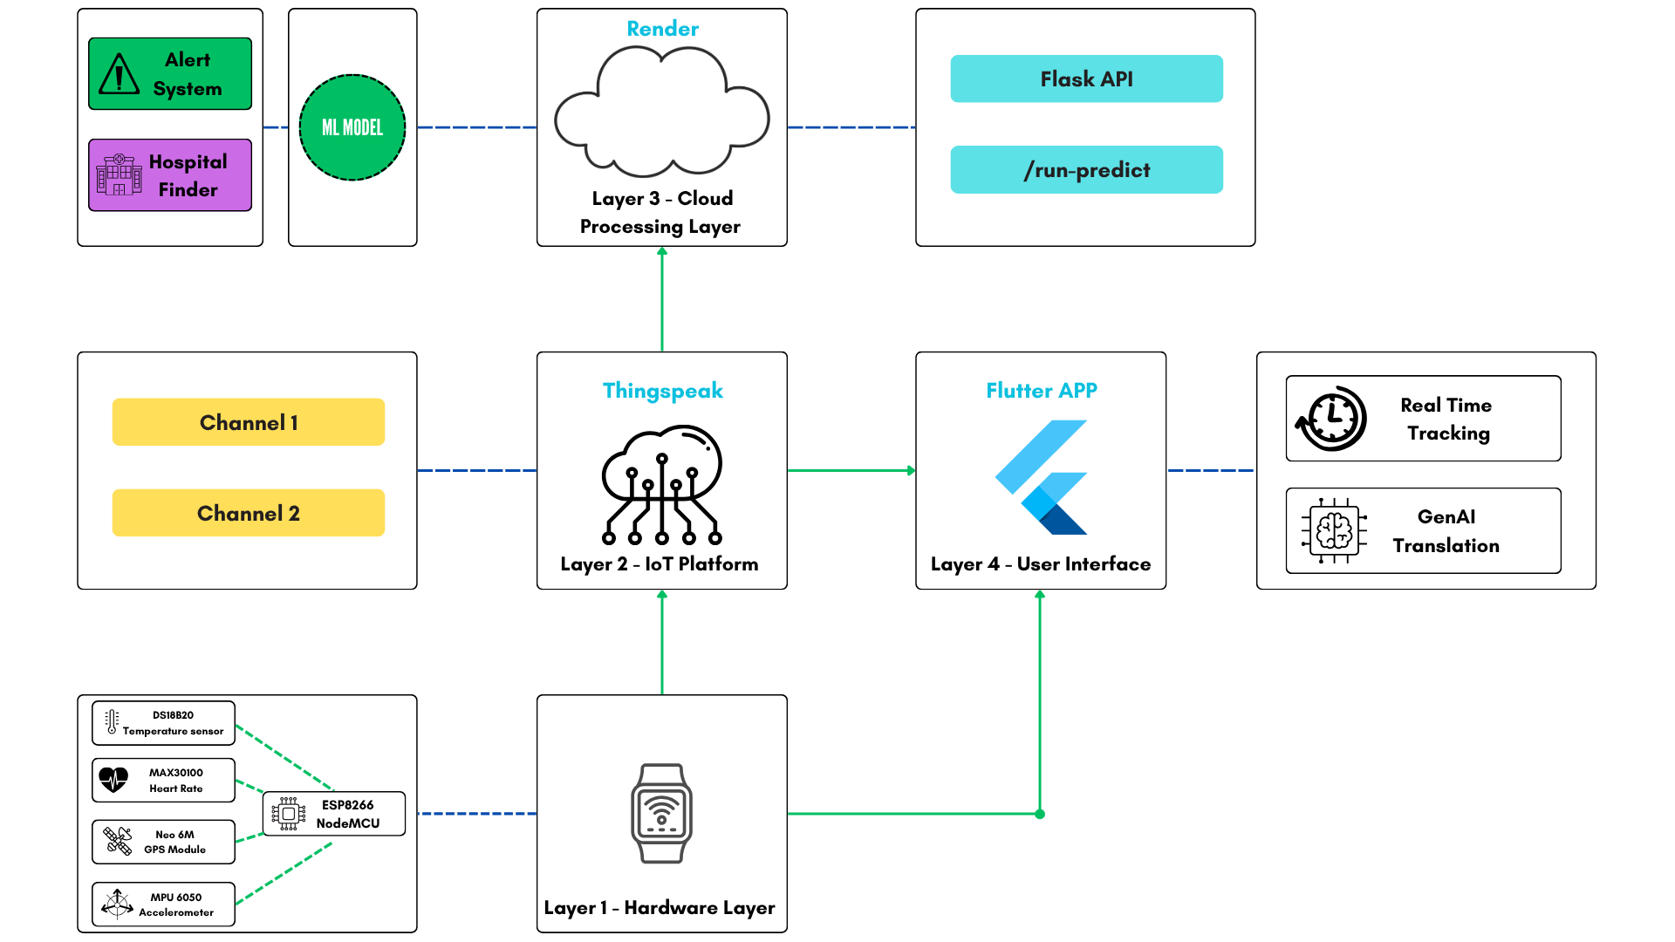
IMPLEMENTATION
INDEX
System Architecture
4

Slide 7
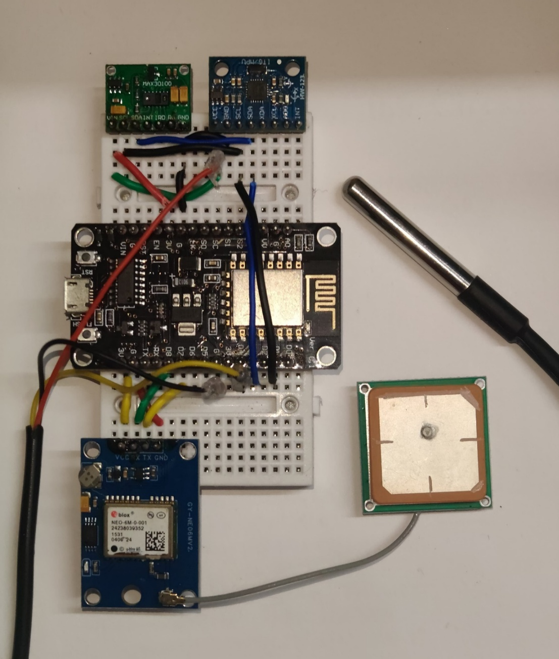
HARDWARE IMPLEMENTATION
INDEX
This custom-crafted wearable device integrates:
MAX30100 Heart Rate Sensor: For accurate pulse and blood oxygen readings.
DS18B20 Temperature Sensor: For continuous body temperature monitoring.
MPU6050 Accelerometer/Gyroscope: Critical for motion tracking and detecting sudden impacts characteristic of falls.
Neo 6M GPS Sensor: Provides precise location data for emergency alerts.
NodeMCU (ESP8266): The microcontroller unit responsible for collecting sensor data, processing it, and securely transmitting it over Wi-Fi.
5

Slide 8
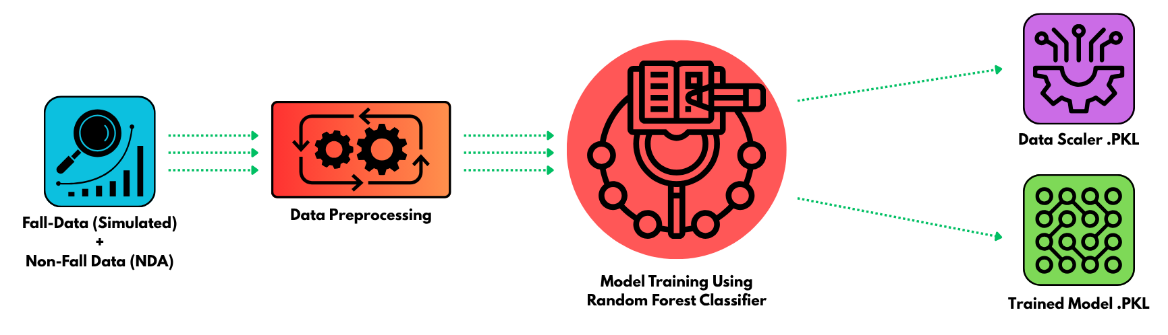
ML IMPLEMENTATION
INDEX
Data Collection : The raw input dataset comprising both simulated fall events and normal daily activities.
Data Preprocessing: The stage where raw data is cleaned, transformed, and prepared for model consumption.
Model Training Using Random Forest Classifier: The process of training a Random Forest algorithm, using an 80/20 train-test split, on the preprocessed data to learn fall detection patterns.
Data Scaler.PKL: A saved object (scaler) used to apply consistent data transformations during both training and inference.
Trained Model.PKL: The final, serialized machine learning model, ready for deployment and making predictions.
6

Slide 9
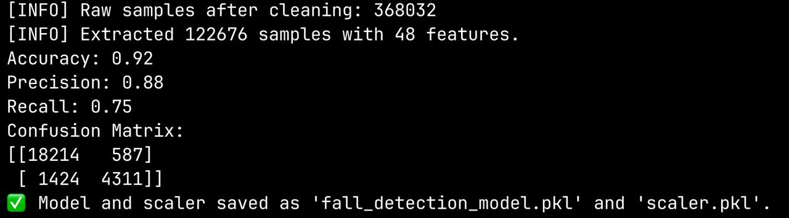
ML TRAINING RESULT
True Positives (TP): 4311 → Falls correctly detected.
True Negatives (TN): 18214 → Non-falls correctly ignored.
False Positives (FP): 587 → Predicted fall, but it wasn't.
False Negatives (FN): 1424 → Missed a real fall.
The model is more careful about calling something a fall
This is common in health systems where false alarms are bad, so models lean toward higher precision.
7

Slide 10
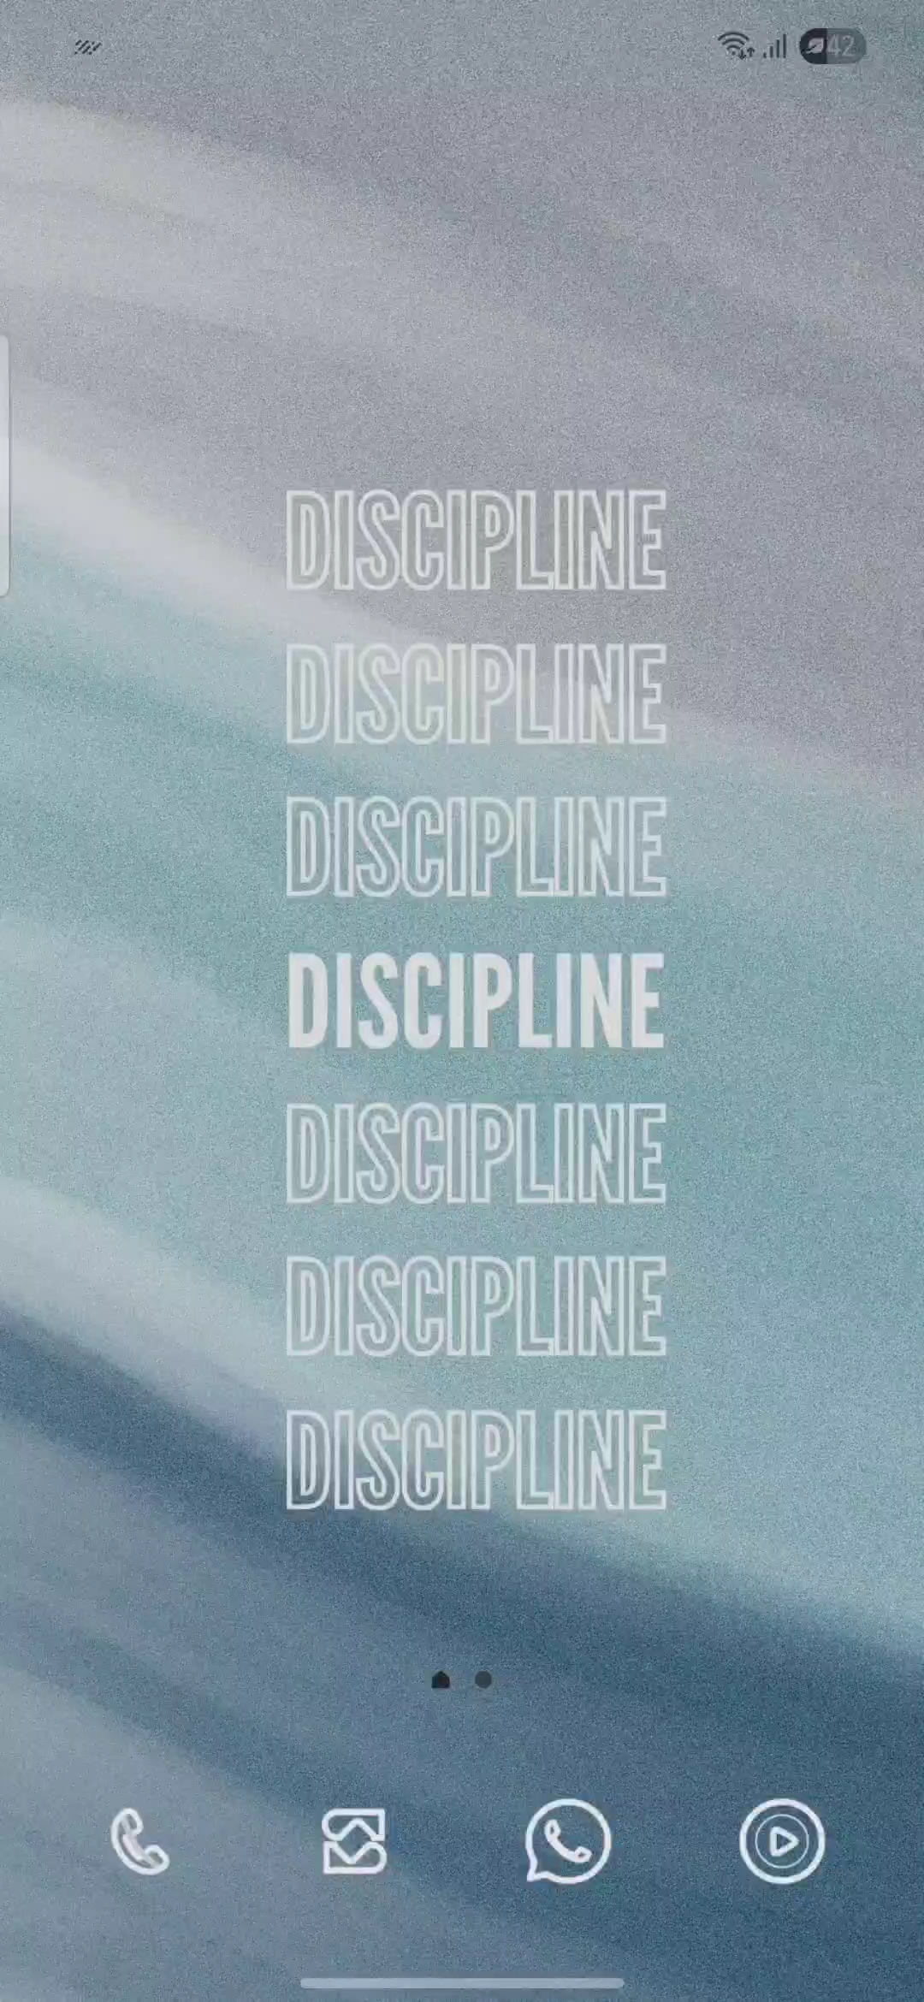
APP UI DEMO
INDEX
Here's a step-by-step user's point of view navigation guide for the VitalSync app:
Launch the app from their phone's home screen.
Enter their full name, age, weight, and height on the "Enter Details" page.
Tap "Next" to proceed.
Grant camera permission if prompted, then scan the QR code on their VitalSync device.
Upon successful scan, they will automatically see the VitalSync Dashboard.
View their Heart Rate, Temperature, Weight, Height, and BMI displayed on the dashboard.
Read the AI Health Insight providing personalized advice based on their current vitals.
Observe the data refreshing automatically every 15 seconds.
If disconnected, they will see a "No internet connection" message and their data will pause refreshing.
To exit, they can press the device's back button or tap the exit icon in the top right corner.
8

Slide 11
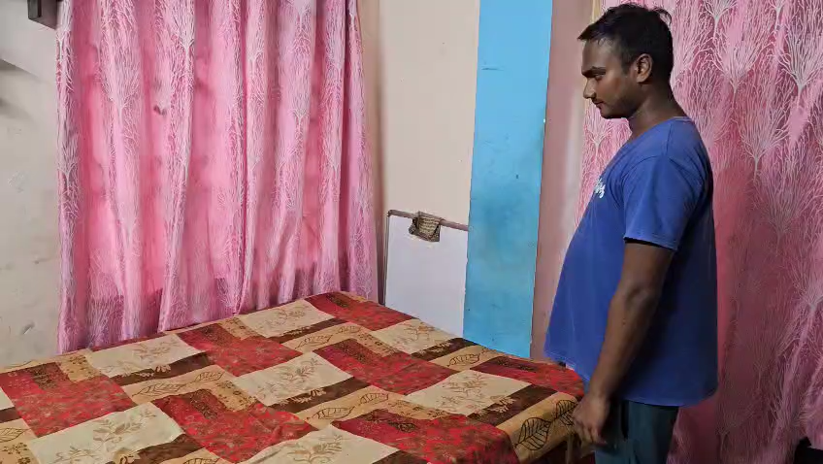
SIMULATED FALL DETECTION AND ALERT SYSTEM DEMO
INDEX
* Simulation of a straight face-first fall to test alert notification
9

Slide 12
INDEX
OUR CONTRIBUTION
Introduction
Comparison of related works
Problem statement
Implementation
Circuit diagram and equipment
Video
Conclusion
Future Work
References
• A fully functional wearable device integrating heart rate, body temperature, accelerometer, and GPS sensors.
• Real-time email alerts with GPS location and hospital mapping.
• A mobile app built using Flutter for health metric visualization and user interaction.
• AI-powered health data translation using GenAI for making metrics easier to interpret.
• Complete cloud-based deployment (via Render) for backend ML inference and alert processing.
10

Slide 13
LIMITATIONS
INDEX
Introduction
Comparison of related works
Problem statement
Implementation
Circuit diagram and equipment
Video
Conclusion
Future Work
References
Battery Life: Continuous sensor and Wi-Fi use requires frequent charging, impacting user adherence.
GPS Accuracy: Location accuracy significantly diminishes indoors.
Wearability: Prototype size and weight may reduce long-term comfort and user compliance.
Sensor Robustness: Environmental noise or interference can affect raw sensor data quality.
Connectivity Reliance: The entire system is dependent on a stable and continuous internet connection.
Third-Party Dependency: Reliance on external APIs (ThingSpeak, Gemini, OpenStreetMap, email) introduces potential points of failure.
User Adherence: Consistent wearing, charging, and app interaction can be challenging for elderly users.
11

Slide 14
INDEX
FUTURE WORK
Introduction
Comparison of related works
Problem statement
Implementation
Circuit diagram and equipment
Video
Conclusion
Future Work
References
Direct Emergency Services Integration: Establish API linkages with hospital emergency systems for automated ambulance dispatch upon fall detection.
Integrated Telemedicine Platform: Implement a virtual consultation feature within the mobile app to connect users directly with healthcare professionals.
Advanced Hardware Miniaturization: Develop a custom Printed Circuit Board (PCB) to achieve a significantly smaller, more durable, and aesthetically pleasing wristband.
Predictive Health Analytics: Implement AI-based analytics to identify long-term health trends and predict potential health issues beyond fall detection.
12

Slide 15
CONCLUSION
This project successfully delivers a comprehensive, low-cost, and real-time health monitoring and fall detection system. By seamlessly integrating IoT sensors, machine learning, and cloud infrastructure with an intuitive Flutter application and GenAI-powered insights, it provides continuous health tracking and ensures rapid, precise emergency response. This user-centric solution, designed for elderly and at-risk individuals, demonstrates significant potential for practical deployment within smart healthcare and telemedicine ecosystems.
13

Slide 16
REFRERENCES
INDEX
Stampfler, Tristan, et al. "Fall detection using accelerometer-based smartphones: Where do we go from here?." Frontiers in public health 10 (2022): 996021.
Amir, Nur Izdihar Muhd, et al. "Development of fall detection device using accelerometer sensor." 2021 IEEE 7th International Conference on Smart Instrumentation, Measurement and Applications (ICSIMA). IEEE, 2021.
Jiang, Zhiyuan, et al. "Fall detection systems for internet of medical things based on wearable sensors: A review." IEEE Internet of Things Journal (2024).
Tian, Jingxiao, Patrick Mercier, and Christopher Paolini. "Ultra low-power, wearable, accelerated shallow-learning fall detection for elderly at-risk persons." Smart Health 33 (2024): 100498.
González-Castro, Ana, et al. "Predicting fall risk in older adults: A machine learning comparison of accelerometric and non-accelerometric factors." Digital Health 11 (2025): 20552076251331752.
Bhargav, M. S. S., et al. "Efficient fall detection for elderly with integrated machine learning and sensor networks." Recent Trends in VLSI and Semiconductor Packaging (2025): 92-100.
Khojasteh, Samad Barri, et al. "Improving fall detection using an on-wrist wearable accelerometer." Sensors 18.5 (2018): 1350.
Introduction
Comparison of related works
Problem statement
Implementation
Circuit diagram and equipment
Video
Conclusion
Future Work
References
14

Slide 17
THANK YOU

